Slide 1

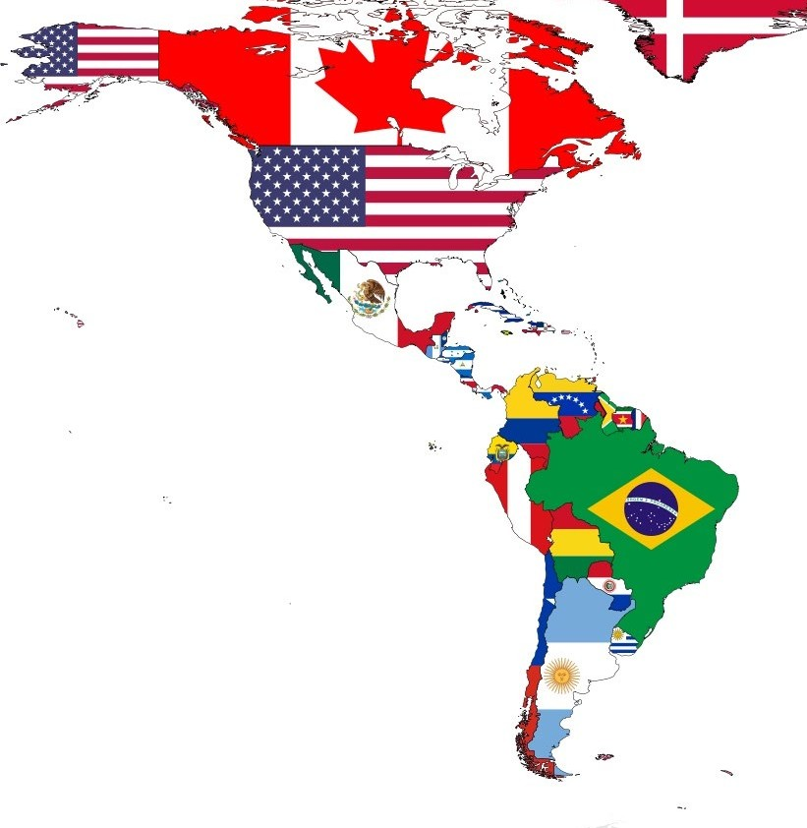


“Oportunidades y Desafíos de Asia Pacífico para Latinoamérica”
Álvaro Echeverría S.
Director
Comté Internacional CNC
Santiago – Chile
8 de Marzo de 2023

Slide 2
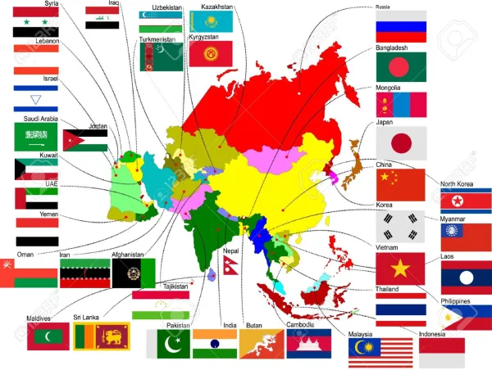
Asia
Población: 4.62 billion
Alrededor de 50 países
PIB: US$36.8 trillion
PIB per cápita: US$7,965
Crecimiento PIB: 5,67%
Exportaciones: US14,56 billion
Importaciones: US13,76 billion
Notes:
HK seeks to be the link connecting international businesses to GBA and to ASEAN, and to connect the two regions to each other.
In other words, Hong Kong promotes a GBA-Hong Kong-ASEAN tripartite partnership, making Hong Kong the super connector between two massive markets.

Slide 3

Visión del mercado Latinoamericano
Factores de riesgo y negativos
Complex governance (risk to democracies ??)
Organized crime and delinquency
Destabilization; social protests and migration crisis
Low competitiveness and economic growth ( Only 1.3% GDP for the region)
Electoral calendar, changes in government, risks, changes in the economic model and possible changes in the productive matrix and import substitution.
Positive Factors
Geopolitics: China-friendly attitude
Seeking sustaining export destinations, collaboration opportunities to transform its economic model(s)
Reliable and resilient supply chain support for its essentials
4

Slide 4

















Nuevos Relatos y Contenidos
US, Canada & Mexico
Focused specific sectors
Thematic approach (with supportive data and cases)
Thematic approach:
ESG
Healthcare/ Wellness
GBA
ASEAN / RCEP
Factors that US businesses are concerned about:
Opportunities in the market;
Fair market access;
HQ strategy (incl. their corporate geopolitical stance);
Free flow of capitals and human resources;
Availability of talents;
...
South America (and selective inland US states)
Broad – general promotion

Slide 5
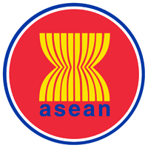
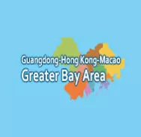
GBA-Hong Kong-ASEAN tripartite partnership
Gateway to GBA
Gateway to ASEAN
Link between GBA & ASEAN
Link between ASEAN/GBA and rest of the world
Hong Kong
Rest of the world
Notes:
HK seeks to be the link connecting international businesses to GBA and to ASEAN, and to connect the two regions to each other.
In other words, Hong Kong promotes a GBA-Hong Kong-ASEAN tripartite partnership, making Hong Kong the super connector between two massive markets.

Slide 6
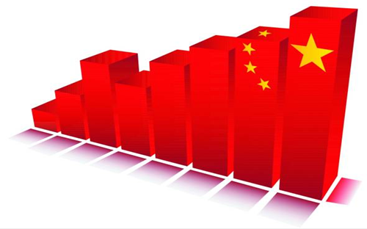
Mainland China
* Población: 1443.5 millones
* Exportaciones: US3364 millones
* Importaciones: US2687 millones
* PIB: 8,1%
* Inflación: 0,9%
* Crecimiento Retail: 1,7%
14º Plan Quinquenal de China
* Consumo doméstico en el continente
* Innovación y tecnología
* Ecología y sostenibilidad
Notes:
Mainland China is a key growth engine in the world economy -- While many economies are still suffering the impact of the pandemic, the Mainland China economy is posting robust growth.
Under the 14th Five-year Plan, the new “dual circulation” strategy is a key direction for economic development. This economic model, with the internal economic cycle or domestic demand as the key growth driver (and domestic demand and external demand boosting each other), offers ample opportunities for international companies.
Bigger consumer market – There are an estimated 400 million middle-class consumers in the mainland, and the number is expected to continue growing in the coming years, This large middle-class population will generate great demand for high-quality /stylish consumer goods and services.
Technological self-reliance aimed – opportunities for innovation and technology sectors.
Green and sustainability is a major theme in the Plan, which aims to achieve “carbon neutrality” by 2060. This will bring business opportunities in related sectors.
Higher logistics efficiency – To strengthen domestic demand, the mainland will increase investment in infrastructure, eg, roads, railways, ports, warehouses, cold-chains, data-centres, internet infrastructure etc. Enterprises will find logistics efficiency higher than before, even in places that were not so developed, like western China. This will mean opportunities for logistics, trading and other business sectors.
HK - link between the mainland and the rest of the world
The Plan spells out Hong Kong’s roles in the Mainland’s overall development strategy. The key word is “International”, which means that the Plan supports Hong Kong’s important role as the link between the mainland and the rest of the world.
The plan supports (for the first time):
building Hong Kong into an international innovation and technology hub - Hong Kong’s strength in this area will help the mainland achieve the goal of technological independence and self-reliance.
building Hong Kong into a regional intellectual property trading centre
enhancing Hong Kong’s status as an international aviation hub
developing Hong Kong into an exchange centre for arts and culture between Mainland China and the rest of the world.
The Plan continues to support Hong Kong in:
enhancing its status as an international financial, transportation and trade centre;
strengthening its status as a global offshore renminbi business hub, an international asset management centre and a risk management centre;
establishing itself as a centre for international legal and dispute resolution services in the Asia-Pacific region; and
Promoting service industries for high-end and high value-added development.

Slide 7


Asian Market can help in growth sectors
- Tecnología e Innovación
- Salud
- Fintech
- Sustentabilidad
- Creatividad y entretenimiento
Notes:
Opportunities
Tech and innovation (including biotech, medtech, healthcare, related technologies, fintech, etc) sectors offer plenty of opportunities in Asia, especially ASEAN and the mainland, as these economies are placing much attention on these sectors.
You can partner with HK to tap these opportunities.
HK’s advantages
1.) Capability in R&D in general:
3 Hong Kong universities ranked among the top 50 in the world in QS World University Rankings 2022. In 2021, HKU and the CUHK also ranked in the top 50 in the medicine category (no update available). (source: https://www.topuniversities.com/university-rankings/world-university-rankings/2022) (Note to ED: This is an update from the last version.)
3 universities in World Top 100 & Top 10 in Asia (Times Higher Education World University Rankings 2021/ Asia University Rankings 2021) (Note to ED: This is from the latest govt fact sheets. It seems “5 universities in top 100” is outdated)
The Government is pressing ahead with the establishment of an InnoHK research cluster on healthcare technologies in HKSTP which will provide opportunities for world-class scientific research institutions and technology enterprises to conduct more R&D projects in collaboration with Hong Kong universities and scientific research institutions.
Hong Kong and Shenzhen will jointly develop a Hong Kong‑Shenzhen Innovation and Technology Park, which will be strategically located at the Lok Ma Chau Loop area. Upon completion, the park will be the largest ever I&T platform in Hong Kong.
In addition, the Government has proposed the launch of a five‑year Global STEM Professorship Scheme at a cost of HK$2 billion to attract outstanding overseas scientific researchers and their teams to set up laboratories and carry out research projects in Hong Kong.
(https://research.hktdc.com/en/article/MzEzOTQ1MjMz)
2) Industry support
Good access to venture funds and capital (leveraging HK’s status as an international financial centre)
Good IP protection from a sound legal and arbitration system:
- Proper legal risk management is crucial for tech and innovation.
- International tech companies can also use Hong Kong’s judicial and dispute resolution systems to protect their IP in Hong Kong and the mainland. As a technology trading platform, Hong Kong is trusted by overseas players, and has already set up arrangements with Mainland China regarding the mutual recognition and enforcement of judgments from arbitration and civil and commercial cases.
- Hong Kong is one of the world’s leading dispute resolution centres. It is ranked the world’s No.3 most preferred seat for arbitration (Queen Mary University of London: International Arbitration Survey 2021)
IP trading and professional services: Hong Kong provides a wide array of professional services in IP trading, management, maintenance and auditing. In this way, Hong Kong can facilitate technology cooperation and transfer between companies from overseas and GBA (including Hong Kong and Shenzhen.)
Free flow of information
Robust digital infrastructure
Ability to pool together innovation resources from the GBA and the world
Entrepreneurial spirit
HKTDC’s work
Leveraging our event platforms, we will showcase Hong Kong’s strengths as a hub for innovation, technology and creativity.

Slide 8
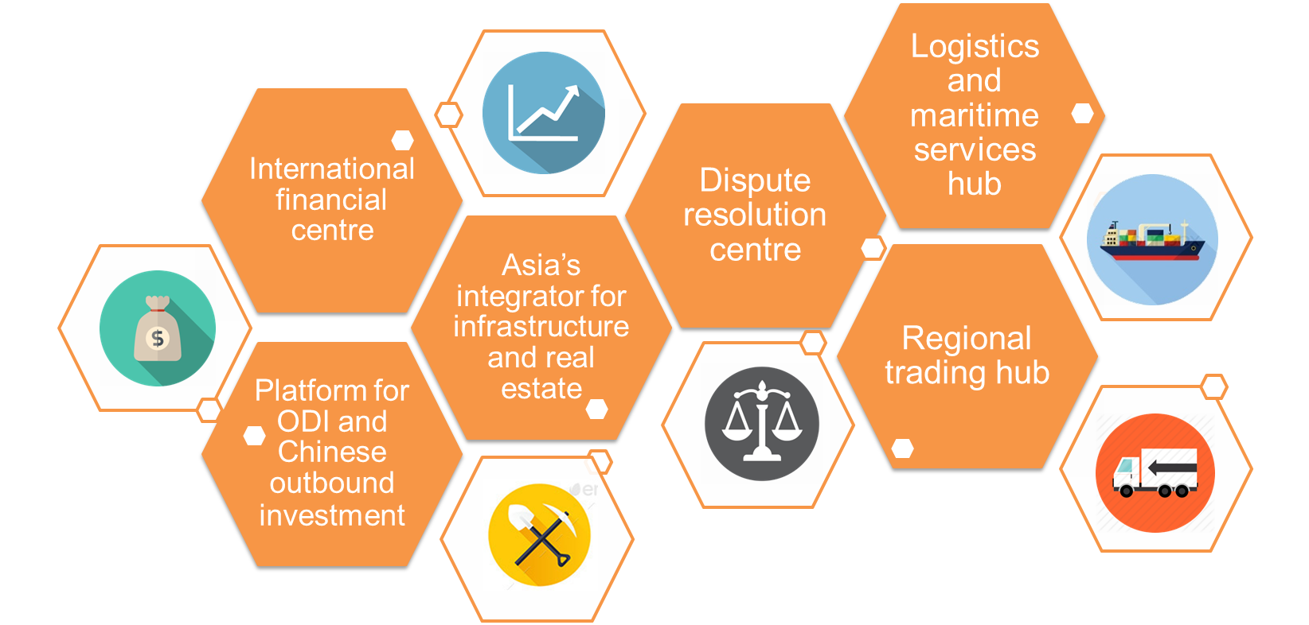


Las ventajas del Asia: los principales sectores tradicionales
Professional services hub
Notes:
HK is
an international financial centre
a platform for ODI and Mainland Chinese outbound investment
Asia’s integrator for infrastructure and real estate
a logistics and maritime services hub
a regional trading hub
a professional services hub

Slide 9
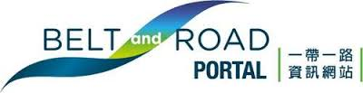
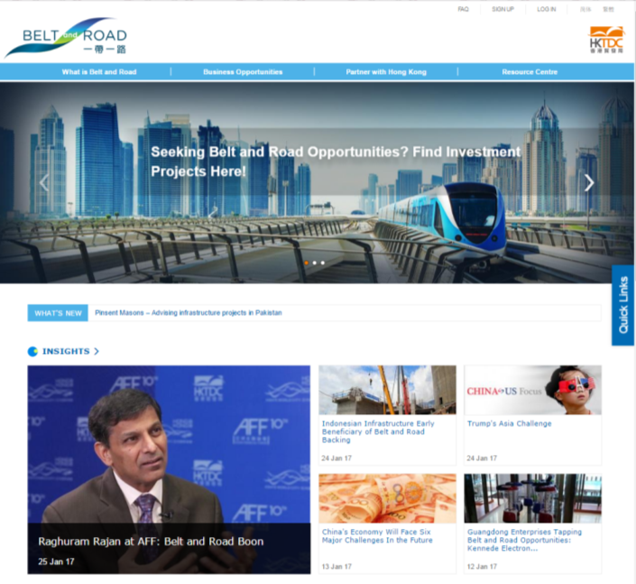
Belt and Road Portal
www.beltandroad.hk
Una plataforma de facilitación de negocios e inteligencia de mercado que incluye
  Perfiles económicos de las economías relacionadas con la Franja y la Ruta
  Información y análisis de mercado más recientes
  Base de datos de proyectos de inversión
  Base de datos de proveedores de servicios de Hong Kong
  Servicio de asesoramiento gratuito
  Documentos políticos oficiales
  Referencias de casos de negocio relevantes
  Eventos relevantes
Notes:
The HKTDC launched a Belt and Road Portal (www.beltandroad.hk) on 7 Dec 2015 which serves as a business facilitation and market intelligence platform for global businesses to seize opportunities arising from the Belt and Road Initiative.

Slide 10
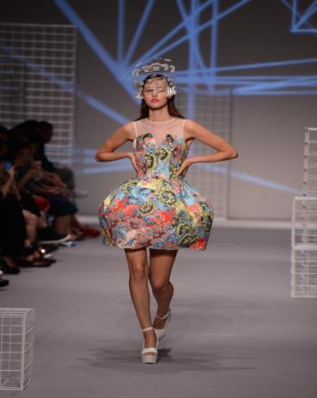
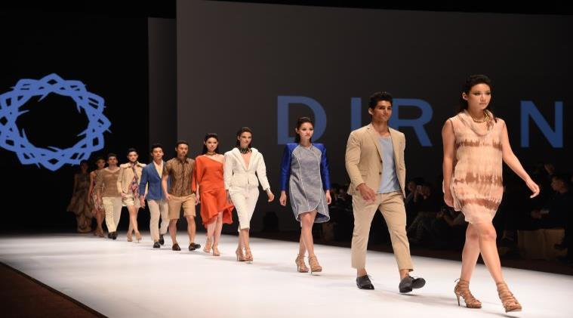
Hong Kong: centro de comercio regional
El estilo de vida que marca tendencia en Asia
Centro de Moda
Notes:
Middle-class consumers in Mainland China, for example, regard HK products and services as trendy and stylish, reflecting not only a fusion of East and West, but also good quality and ample choices. This advantage is bolstered by HK’s reputation as the shop window for Asia and a regional fashion centre. We are ideally placed and equipped to help overseas companies expand into Asia.
Shop Window for Mainland and Asia
HK the ideal product marketing platform and showcase for overseas suppliers to launch their products to Mainland China and other parts of Asia, and even global markets. This role is cemented by our world-class international trade fairs. On the other hand, HK is a sourcing hub for overseas buyers to source stylish, quality products of different origins. I will elaborate on these trade fairs later.
Fashion Design -- An Asian Fashion Centre
HK is one of the world’s key suppliers of clothing and clothing accessories, and an emerging design talent centre. HK fashion designers are known for their unique ability to synthesise Western and Eastern cultures, which makes their creations stand out. They have been gaining worldwide reputation for their professional expertise, sensitivity to current trends and ability to blend commercialism with innovation.
The rapid expansion of the Mainland Chinese economy has resulted in consumers becoming more fashionable and brand-conscious. Hollister and FOREVER 21 have opened flagship stores in HK to use the city as a platform to go across the border. France’s Galeries Lafayette formed a joint venture with HK fashion conglomerate I.T Ltd to open a Galeries Lafayette department store in Beijing I October 2013.
Some HK fashion designers are helping overseas brands customise their products for the mainland market. Examples:
A company under HK’s Chung Nam group has been partnering with UK fashion brand Oasis to produce products for the mainland market.
Japanese fashion designer Yohji Yamamoto, Chinese fashion designer Mao Jihong (behind Chinese fashion brand Exception de Mixmind) and HK designer Stanley Wong have collaborated to create Guangzhou-based fashion brand YMOYNOT.
Some HK fashion designers have built a presence in international markets, such as Europe and America. These include Vivienne Tam Johanna Ho, Hidy Ng, Dorian Ho, Manix Wong, Erbert Chong, and brands such as Ground Zero, I.T., Shanghai Tang, Jessica, Michel René, MOISELLE, ÓPA, G2000, Blanc de Chine, Wanko, Giordano, Baleno, Bossini and Qeelin (jewellery). Other leading HK designers who serve international clientele include Barney Cheng, Walter Ma, Lulu Cheung, Peter Lau, Bonita Cheung, Harrison Wong.
HK designers are also making inroads in emerging markets, including Istanbul, Budapest, Dubai and Moscow.
Medium- to high-end fashion bearing HK designer labels is being sold/has been sold in renowned department stores overseas, such as Bloomingdale's, C&A, Harrod's, Isetan, Macy's, Marui, Mitsukoshi, Nieman Marcus and Seibu.
Overseas fashion brands and companies can also use the HK platform or partner HK companies to enter Asia.
HKTDC’s fashion events:
HKTDC Hong Kong Fashion Week for Fall/Winter
CENTRESTAGE is a dedicated marketing platform for international and regional brands and designer labels, especially those from Asia, to feature their ready-to-market collections targeting fashion media, buyers and invited consumers. It also serves as a premier launch pad to showcase the latest/new collections to the fashion industry.

Slide 11
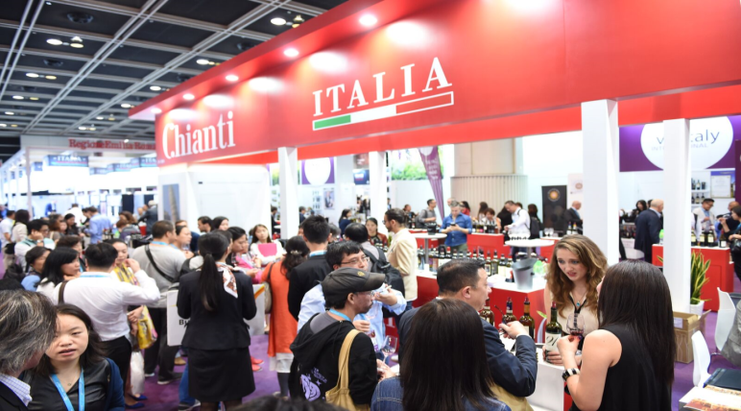
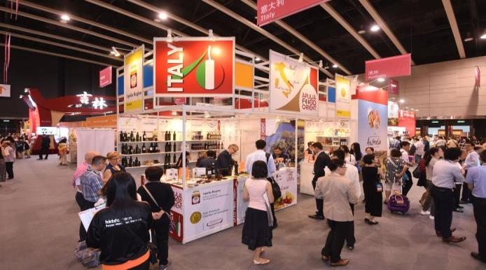
Hong Kong: centro de comercio regional
El estilo de vida que marca tendencia en Asia
Centro de distribución de vinos y alimentos
HKTDC Hong Kong International Wine & Spirits Fair
HKTDC Food Expo
Notes:
Food & Beverage
HK is a key food and wine trade platform, which overseas companies can use to expand into Asia.
HK is dubbed a “gourmets’ paradise” because we import the best food products from round the world. As such, it is an important market for your food and beverage sector.
Wine
Hong Kong's wine industry is supported by a significant pool of experienced fine wine merchants with good wine knowledge and international wine trade experience.
Besides wine trading and distribution, wine-related business includes auction, retailing, warehousing, catering and transportation.
Since the removal of all duty-related customs and administrative controls in February 2008, Hong Kong has further developed into a wine trading and distribution centre for the region, particularly for Mainland China.
Hong Kong runs the world's first accreditation scheme for wine storage facilities, and our Customs stands guard against counterfeit wines. Together, that adds up to confidence in the wine that we sell here in Hong Kong.
Our wine trade has been booming since wine duties were removed in 2008.
To facilitate Hong Kong as a trading and distribution hub for the region, the Hong Kong government has signed co-operation agreements with Australia, Chile, France (and its Bordeaux and Burgundy regions), Germany, Hungary, Italy, New Zealand, Portugal, Romania, Spain and the United States (and its Oregon and Washington states) to strengthen promotional activities in areas including wine-related trade, investment and tourism.
Hong Kong's wine trade network extends well beyond local and Chinese mainland markets, and includes major Asian economies such as Japan, Korea and Taiwan, as well as ASEAN nations.
We are seeing:
a growing demand in the mainland, a healthy development of the hugely promising wine market at our doorstep.
A growing mainland preference for consuming wine from trendsetting Hong Kong. But more than following our vogue for wine, mainlanders trust our taste, they trust our integrity.
prodigious wine prospects under the Belt & Road initiative.
The HKTDC Hong Kong International Wine & Spirits Fair is an important industry promotion and trading platform for wine suppliers to expand their business to Mainland China and throughout Asia..
Food
Apart from consuming imported foods, we also help distribute imported foods into the mainland through our established distribution and retail networks.
The potential of the mainland food market is huge. The Chinese are a gourmet-loving people, and safe, pollution-free and quality food items are much sought after. Moreover, with increasing spending power, consumers have shown markedly higher demand for packaged food and beverages from overseas.
As such, there are plenty of opportunities for overseas food and beverage sectors to tap the Asia and particularly the mainland market through HK.
Your food suppliers and processing companies can:
source ingredients from Mainland China through HK companies, which are strong in conducting mainland sourcing and quality control, such as pesticide residue detection and organic certification.
sell to the mainland via HK (Keeping inventory in HK and shipping products to the mainland only when there is actual demand involves relatively low tariff costs and risks. HK also offers good support in trademark protection, product tracking management, brand name marketing and logistics, especially the consolidation and distribution of small orders to different regions in Mainland China, and professional handling of high-price products that require stringent temperature control such as chocolate, cheese and ice-cream.)
sell to the mainland by partnering with HK food traders, who have good knowledge of the market and can advise on the preferences of mainland consumers in such areas as product development, brand building, market promotion and package design and labelling requirements.
Our Research studies have found that overseas suppliers are assured of the effectiveness of HK as a platform to introduce their food products to the mainland market.
Our HKTDC Food Expo is popular with international food traders.

Slide 12

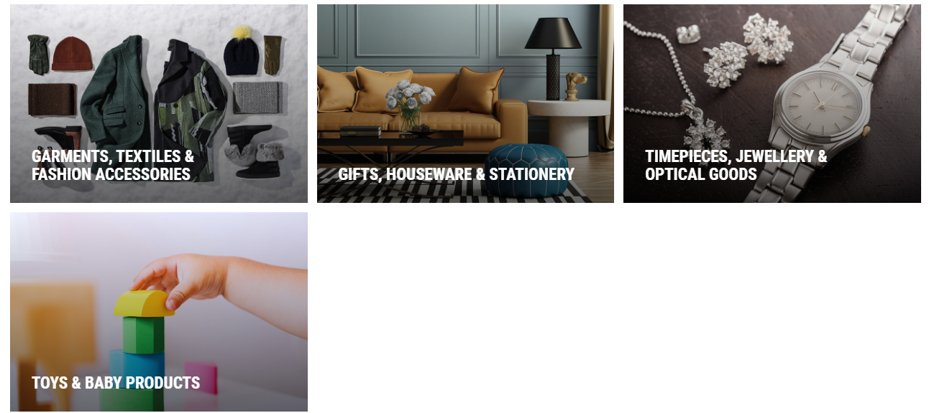

Slide 13
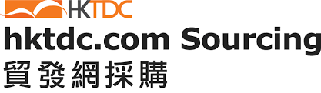

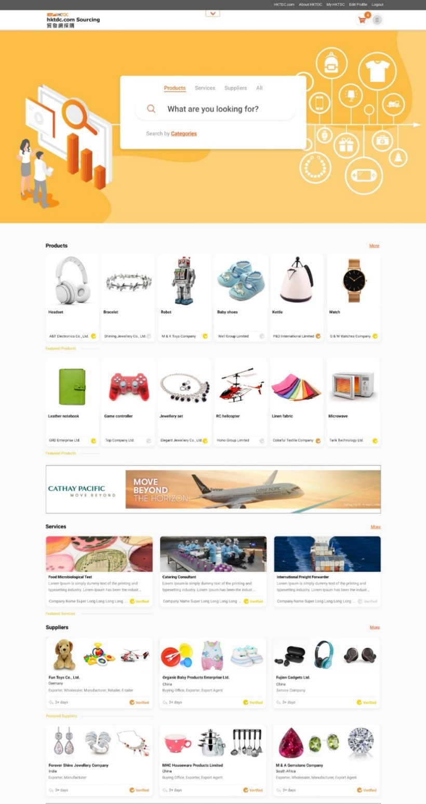


2M+ registered buyers
130,000+ quality suppliers
5M monthly user sessions
24M+ business connections generated annually
hktdc.com Sourcing 2.0
Nueva interfaz, mejor experiencia de usuario
Mayor eficiencia, mejores coincidencias, negocios más rápidos
Recomendaciones personalizadas
Proveedores verificados
Notes:
The hktdc.com Sourcing is re-launched in October 2020 to offer a better user experience, and address the growing needs for innovative and cost-effective sourcing solutions. [Note: Soft launch on 5 October; full launch on 30 October.]
New platform interface enables buyer to navigate smoothly and search for interested products at the homepage right away.
With latest AI and machine learning technologies, hktdc.com Sourcing offers a more efficient, accurate and personalised searching experience helping buyers to find better match and faster deals.
Suppliers' information, production capabilities and certificates verified by third-party authorities are available to help buyers make the right choices.

Slide 14














HKTDC: Marketing & Sourcing Trade Fairs
Más de 30 ferias mundiales
Ejemplos:
Fashion
Fall/Winter
Electronics
(Spring)
Watch & Clock
Gifts & Premium
Toys & Games
Houseware
Electronics (Autumn) + electronicAsia
Jewellery +
Diamond,Gem & Pearl
Lighting (Autumn)+
Outdoor Lighting
Licensing
FILMART
Notes:
The HKTDC also offers services to promote trade, including trade fairs, different forms of business-matching services, and business missions.
The HKTDC, HK’s largest fair organiser, organises more than 30 exhibitions a year
As well as sourcing opportunities, our fairs are marketing shows where brands are launched. Overseas traders are well aware of our fairs, and the business they can bring.

Slide 15

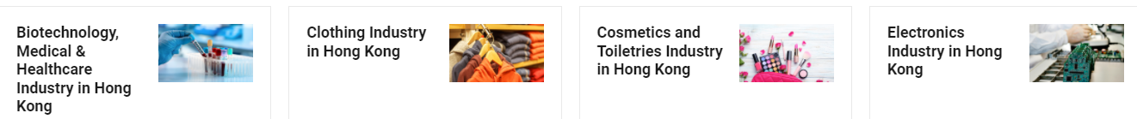
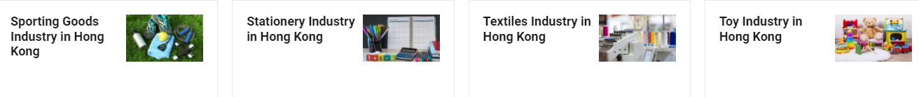
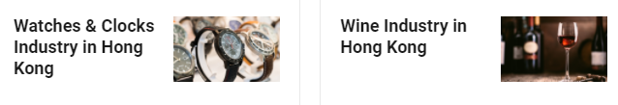

Slide 16
Areas y Sectores de Oportunidades en Latinoámerica
Themes:
Fundraising
Asian credit lines
Student exchange programs, scholarships
Areas:
Agriculture
Logistics
Machinery
Healthcare
Food
Merchandise:
Jewellery and tools for jewellery
Healthcare
Toys
Computer accesories
Office equipment
Electronics
Wine / Food
Pre-fabricated houses
Hardware and Machinery
Outdoor products
16

Slide 17


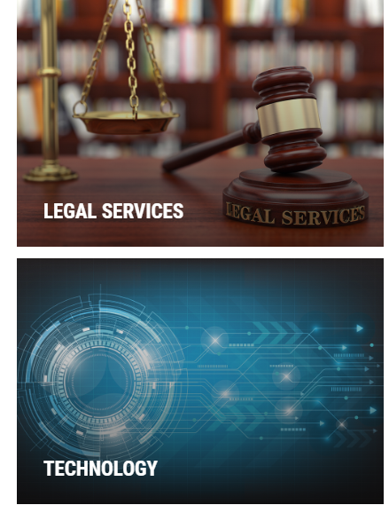



Slide 18
Indicadores de restricción de viajes de negocios al Asia
Population: 50+ company responses
Buyers were asked to choose the top three issues which have affected their business during the pandemic.
Below are the selection of factors:
Travel restrictions | 56% | Taxes/Tariffs | 28%
Production Costs | 48% | Geopolitics | 19%
Supply Chain | 48% | Labor issues/ | 7%
Travel Costs (air/hotel) 44% Staff shortage
US Economy | 28% o Business is great! 6%
16

Slide 19
Cuadro comparativo de costos pre y post COVID
 | Pre-Covid (Jan 2020) | Jan 2023
Average Flight Cost | Economy Non-Stop JFK-HKG Round Trip USD1,250 | Economy Non-Stop JFK-HKG Round Trip USD2,500
Major Carriers | CX, AA, UA with direct flights out of 7 US cities | CX, AA direct out of 3 cities - LAX, SFO, JFK (UA to resume Mar 2023)
 | 112 non-stop flights per week (CX 77 / UA 35) | 26 non-stop flights per week (CX only) As at Jan 25, 2023
Starting Mar 23, 2023, UA resumes.
40 non-stop flights per week
17

Slide 20
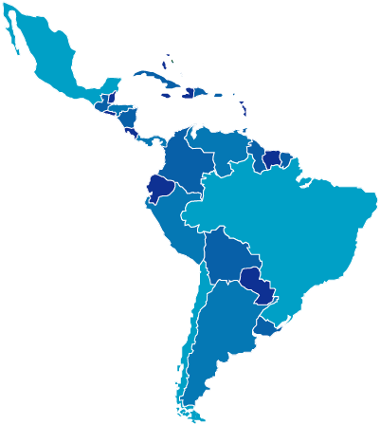
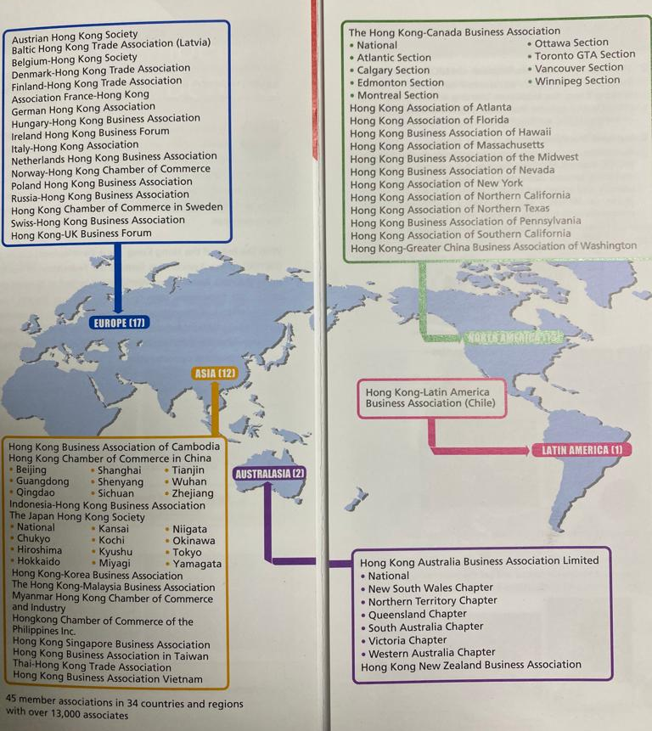
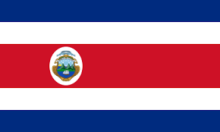
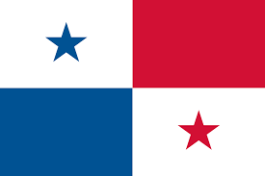





Secretarias Regionales
Organigrama Regional
Oficina Regional Chile
Secretarias Regionales
Perú
Costa Rica
Panamá
Bolivia
Colombia
Uruguay

Slide 21
Principales Servicios de la Cámara de Comercio Asia Pacifico
Inteligencia y promoción comercial
Business Matching
Misiones Comerciales
Capacitación
Certificación en destino
Red de aliados y contacto comercial
Eventos y networking
Proyectos estratégicos
Web ://asiapacific-chamber.com/

Slide 22

Apoyándose en CNC
Integración
Networking
Conocimiento
Experiencia
Capacitación
Diversidad
Cobertura
Servicios
Desde Nuestras Cámaras
Información sectorial
Contacto nacional, regional e internacional
Diversidad de áreas y rubros
Localización Regional
Servicios varios
Reputación y trascendencia

Slide 23
Necesidades y desafíos desde las Regiones para sector público, institucional y empresarial
Educación y formación internacional
Redes, contactos, experiencias y conocimientos
Confianza, certeza, pasión y compromiso
Institucionalidad, clima, ambiente favorable de negocios
Estrategias, inteligencia y planificación
Tecnologías, innovación y digitalización
Visión, proyección de futuro

Slide 24

Thank you!
Álvaro Echeverría
Cámara de Comercio Asia Pacifico
dsanchez@asiapacific.com
www.asiapacific-chamber.com
+56 2 22255015

